Slide 1

Clean Street
A Platform for Community-Driven Civic Issue Reporting and Resolution
Team-2

Slide 2
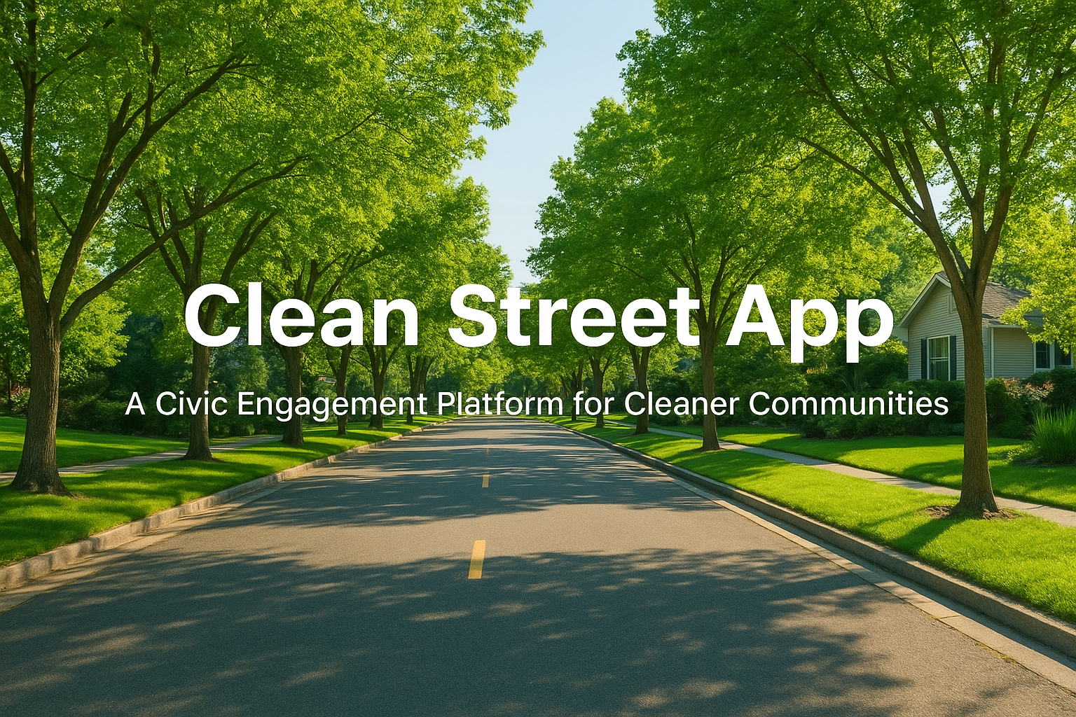
Technology Stack: MERN
MongoDB
- Flexible NoSQL database for storing complaint and user data.
Express.js
- Fast and minimal web framework for backend API.
React.js
- Dynamic and responsive user interface.
Node.js
- Scalable JavaScript runtime powering the backend.

Slide 3
Core Features
Citizen Reporting
- Report civic issues with images and map locations.
Admin Management
- Dashboard for tracking, managing, and analyzing complaints.
Volunteer Workflow
- Volunteers receive tasks, update status, and resolve issues.

Slide 4
Outcomes and Impact
Faster Issue Resolution
- Reduces time for identifying and resolving issues.
Increased Transparency
- Real-time status tracking for trust and accountability.
Improved Community Engagement
- Empowers citizens to improve neighborhoods.

Slide 5
User Roles & Permissions
The Citizen
- Reports issues, uploads evidence, tracks progress.
The Volunteer
- Handles assigned tasks and updates issue status.
The Administrator
- Manages complaints, data analysis, and user roles.

Slide 6
Challenges and Solutions
Challenge 1: Accurate Location Data
Solution: Integrated interactive Leaflet map.
Challenge 2: Managing Permissions
Solution: Role-based access control using JWT.
Challenge 3: Data Visualization
Solution: Admin Dashboard with charts.
Challenge 4: Multiple Image Uploads
Solution: Multer backend file handling.

Slide 7
Application Showcase
Recommended screenshots:
- Login Page
- User Dashboard
- Report Issue Form
- View Complaints Page
- Complaint Details Page
- Admin Dashboard

Slide 8

Demo Presentation

Slide 9


Our Team
Nandini Sri Laxmi Prasanna Deepak Reddy

Slide 10

Q&A

Slide 11


